Slide 1
Infection Prevention and Control

Slide 2
objectives
Understand how bacteria and viruses are spread or transmitted in the hospital setting
Understand what Routine Practice means
Describe common healthcare associated organisms acquired by patients during hospitalization (nosocomial infections)
Understand additional precautions
Notes:
All health care providers should have a basic understanding of infection prevention and control practices. The purpose of this presentation is to give health care providers at The Ottawa Hospital the knowledge they need to provide health care that is safe for patients and themselves.

Slide 3

Infectious Agent
Bacteria, Fungi, Viruses,
Parasites, Prions
Susceptible Host
Reservoirs
Immunosuppression, Diabetes,
Burns, Surgery, Age
CHAIN
OF TRANSMISSION
People, Water, Food
Portals of Exit
Portals of Entry
Blood, Secretions,
Excretions, Skin
Mucous membrane, Respiratory
GI, Broken Skin
Modes of Transmission
Contact, Droplet, Airborne
Notes:
Causative Agent:
First link of the chain
To cause disease, the agent has to be invasive enough to enter tissues, multiply and cause damage
Specific to the host; example zoonotic disease usually doesn't affect humans; so in other words , an organisms that makes a horse or a pig sick will not have much success in causing a human to be sick.
Some organism have the ability to change
Human Influenza has the ability to circumvent our immune systems by changing it’s presentation (protein outer layer) and that’s why TOH strongly encourages all staff to receive their annual vaccination.
Reservoir:
Common Reservoirs associated with hospital acquired infections include patients, Health care providers and the environment (shared equipment)
Humans are either Carriers (doesn’t make you sick but you can spread to others)
For example some people are carriers of MRSA/VRE but it never makes them sick
Portal Exit/Entry:
These encompass the various ways that organisms can enter and exit to body
Mode of Transmission:
This is how the causative agent reaches the susceptible host
Susceptible Host:
Factors that allow some people to get sick from an organism while some people with the same organism stay healthy
So infection control involves breaking the chain of infection by altering either the host, the environment or the agent.
Can anyone tell me, what link is the easiest to break by the HCW?---

Slide 4
Routine Practice
Same safe standards for all healthcare providers
Assess the risk of healthcare provider (HCP) exposure to bacteria and viruses via blood and body fluids
Assess the patient factors that increase risk of spread of bacteria and viruses
Notes:
Routine Practices are the foundation for preventing transmission or spread of micro-organisms. They are to used for care of all patients at all times by all health care providers.
It is the responsibility of all health care providers to follow infection prevention and control policies and to provide care in a safe manner that protects both the patients and themselves.

Slide 5
Routine Practice
5 Basic Elements of Routine Practice:
Hand Hygiene
Cleaning of Shared Equipment
Risk Assessment
Personal Protective Equipment (PPE)
Patient Placement
Notes:
There are 5 basic elements of Routine Practice. Each one will be discussed in more detail throughout this presentation

Slide 6
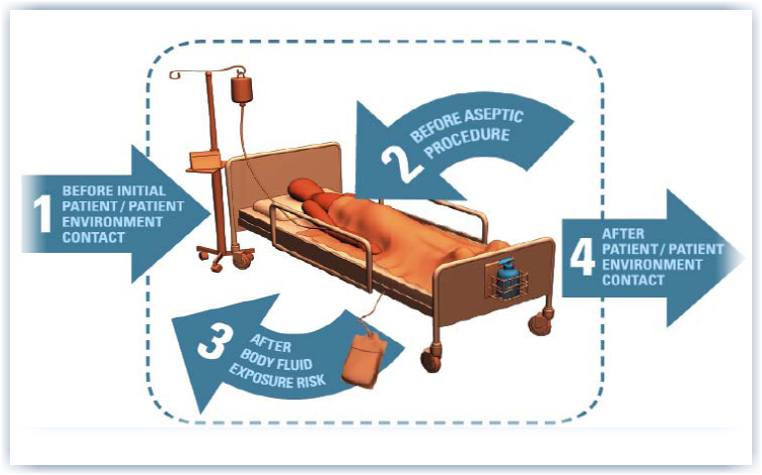
Hand hygiene
Hands are the most common carrier of bacteria and viruses that spread throughout the hospital
Hand hygiene is something every health care provider can do to help to reduce the amount of infections acquired by hospitalized patients
Remember your four points of hand washing!!!
Notes:
The first element of Routine Practice is Hand Hygiene.
Hand Hygiene means cleaning your hands.
To understand the importance of hand hygiene, below you will find the 5 steps which contribute to the spread of germ by the hands of health care providers:
Bacteria and viruses present on patient skin and environmental surfaces
Bacteria and viruses transfer on health care provider hands
Bacteria and viruses survive on hands
Defective hand cleaning results in hands remaining contaminated
Contaminated hands cross-transmit bacteria and viruses
At The Ottawa Hospital there are two ways in which we instruct our health care providers to perform hand hygiene:
Use Alcohol Based Hand Rub for at minimum 15 seconds
or
Wash hands with soap and water for at minimum 15 seconds
When hands are not visibly soiled, either way is acceptable. When hands are visibly soiled, use soap and water.

Slide 7

Patient centered hand hygiene program
Patients will clean their hands:
  Before meals
  Before medications
  Before entering and exiting the room
  After using the bathroom

Slide 8
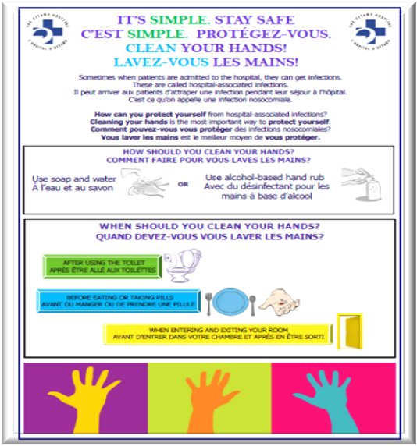
Patient centered hand hygiene program
Cleanable poster for patient room

Slide 9
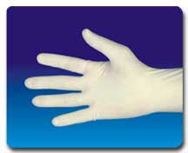
Routine Practice
Hand Hygiene: Glove use
Do assess the need to use gloves before beginning task
Do clean hands and put on gloves just prior to entering the patient care area
Do remove gloves immediately after completing the task
Do Not use gloves as a substitute for Hand Hygiene
Do Not wear gloves outside the patient care area unless handling soiled equipment
Do Not use the same gloves for more than one patient
Notes:
This slide is some basic instructions for health care providers on glove use.
Below you will find some additional points about glove use.
Gloves used in clinical areas are single-use and task-specific
Health care providers should select the most appropriate glove for the anticipated task
Perform hand hygiene before putting on gloves for aseptic procedures
Perform hand hygiene after removing gloves
Change or removes gloves if moving from a contaminated body site to a clean body site of the same patient
Change gloves and perform hand hygiene if a tear is noticed in the glove
Do not wash or disinfect gloves

Slide 10
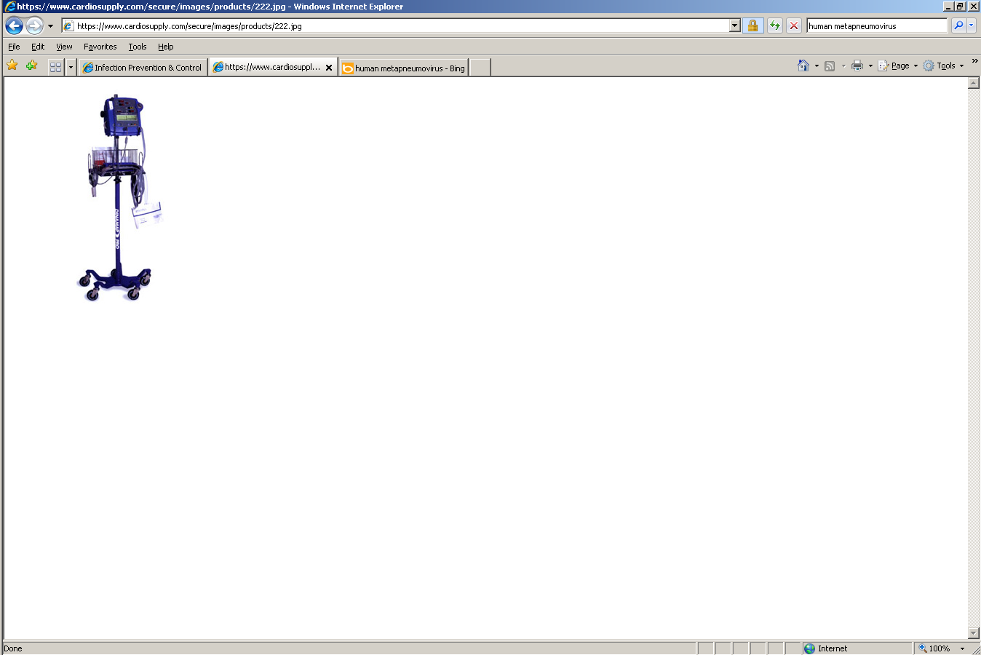
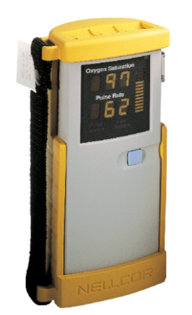
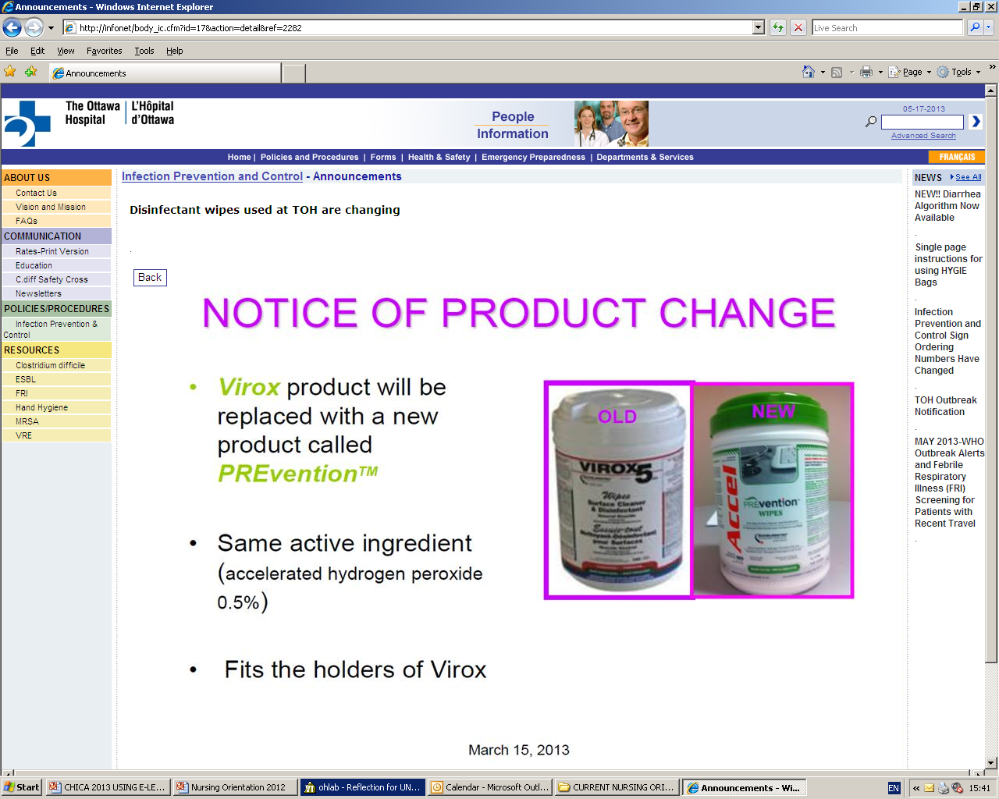
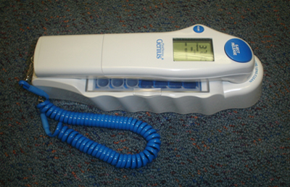
Routine Practice
Cleaning of shared equipment
  In between all patients
  When visibly soiled
Notes:
Health care providers who use shared patient-care equipment in the assessment, examination, care, or transport of a patient are responsible for cleaning and disinfecting that piece of equipment after each use on every patient. Equipment must be cleaned using a hospital grade low level disinfectant. Accel Prevention® wipes is an example of hospital grade low level disinfectant which is acceptable to use on most equipment.
In the event equipment becomes soiled with organic material (e.g. blood or body fluids), the organic material must be removed from the item prior to disinfection.
HCPs should expect that any shared patient-care equipment has been cleaned before they use it on another patient (or before returning the equipment to its normal access point). If equipment appears to be visibly soiled before use on a patient, it must be cleaned and disinfected prior to use.

Slide 11
Risk assessment
Risk assessment should be done before each patient interaction as patient status can change
HCP must assess the risk of exposure to blood, body fluids and non-intact skin and use measures to decrease risk
Used to reduce the spread of bacteria and viruses in the hospital
Notes:
Another element in the effective use of Routine Practice is to perform a risk assessment.
A risk assessment must be done before each patient interaction in order to determine which interventions are required to prevent transmission of bacteria and viruses during the interaction, because the patient’s status can change.
Health care providers must assess the risk of exposure to blood, body fluids and non-intact skin and identify the strategies that will decrease exposure risk and prevent the transmission of bacteria and viruses.
Assessing Risk of Transmission/spread of bacteria or viruses
1) The risk of transmission of microorganisms between individuals involves factors related to:
the patient infection status (including colonization);
the characteristics of the patient;
the type of care activities to be performed;
the resources available for control
the health care provider immune status.
2) contamination of skin or clothing by microorganisms in the patient environment
exposure to blood, body fluids, secretions, excretions, tissues
exposure to non-intact skin
exposure to mucous membranes
exposure to contaminated equipment or surfaces

Slide 12
Risk assessment
  Wear gloves when hands may be in contact with mucous membranes, non-intact skin, tissue, blood, body fluids and environmental surfaces contaminated with above
  Wear a gown when it is anticipated that care is likely to generate splashes or sprays of blood and/or body fluids
  Wear a mask and eye protection to protect the mucous membranes of the eyes, nose, and mouth when care is likely to generate splashes or sprays of blood and/or body fluids
Notes:
The above slide notes the measures that can be used to decrease exposure risk and prevent the transmission of bacteria and viruses.

Slide 13

Routine Practice
Personal Protective Equipment
Notes:
This is a video that correctly illustrates how PPE should be put on and taken off. The only exception to this video would be if you have a patient on Airborne Precautions, in which case the N95 respirator would be removed outside the patient room.

Slide 14
Routine practice
Patient Placement
When caring for an individual, assess the potential risk of transmission to others
  Is the patient soiling their environment?
  Is the patient a known carrier of a multidrug resistant bacteria?
  Does the patient have a new onset cough/SOB and fever?
Place patient in appropriate room and/or additional precautions
Notes:
Health care providers must assess patient placement on a regular basis, as the status of a patient may change.
If a infectious process is suspected in a patient, place patient in appropriate room and/or additional precautions immediately, do not wait for laboratory confirmation of disease.
Notify Infection Prevention and Control when required placement is not available

Slide 15
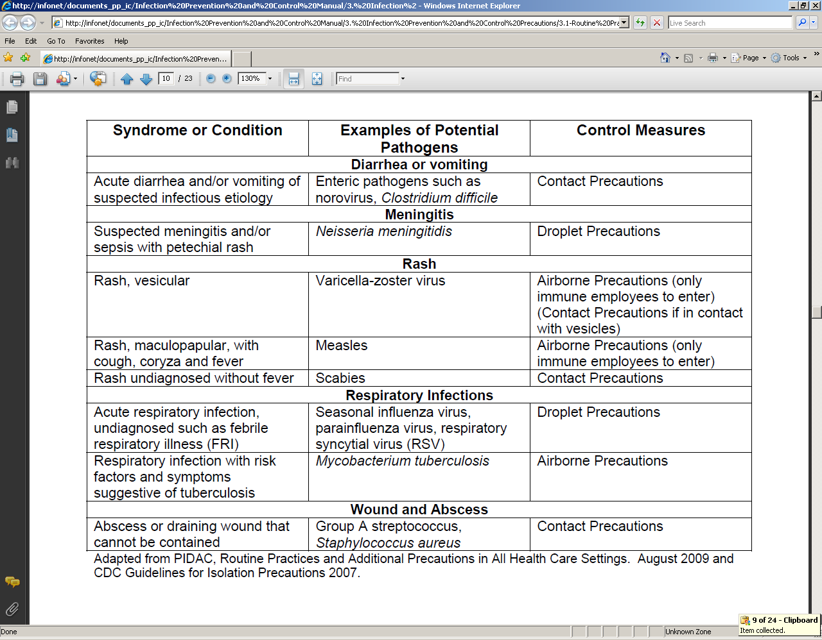
Routine practices
Patient Placement
Notes:
This table of Clinical Conditions Requiring Additional Infection Control Measures can be found as an appendix in the Infection Prevention and Control policy #3.1 Routine Practices.
This table serves as a guide for health care providers to ensure appropriate patient placement should an infectious disease be suspected.

Slide 16
Health Care associated organisms
Health care associated organisms include:
Clostridium difficile
Group A Streptococcus
Shingles
FRI
Antibiotic Resistant Organisms (ARO)

Slide 17
Clostridium difficile
C. difficile causes infectious diarrhea in hospitalized patients
Some C.difficile bacteria strains produce dangerous toxins
Risk factors for getting C.difficile include increased age, prolonged hospitalization, antibiotic use, and prior gastrointestinal surgery
Patients are at risk of ingesting C.difficile spores transmitted on surfaces or health care provider hands
Notes:
Patients with C.difficile may be asymptomatically colonized, have C.difficile associated diarrhea (CDAD) or develop a serious complication such as pseudomembraneous colitis, toxic megacolon, and perforation of the colon. C.difficile spores can persist in the environment for months.
As well as health care provider hands, patient care items and the environment can be contaminated with C.difficile.

Slide 18
Clostridium Difficile
Common symptoms of an infection with C.difficile include nausea, vomiting, diarrhea, or abdominal pain
If your patient has 2 or more episodes of undiagnosed diarrhea, place on contact precautions send a stool sample to test for C.difficile
Once diarrhea has resolved (more then 48hrs since last diarrheal episode), patient can be removed from contact precautions but room will need to have a terminal clean with Clorox (even if patient remains in room)
Notes:
If you have a patient who presents with 2 or more episodes of undiagnosed Diarrhea, place on contact precautions, and send a stool sample to the lab for testing. If possible dedicate equipment to be used only on symptomatic patient.
Once your patients Diarrhea has resolved and it’s been more then 48 hours since the last diarrheal episode, you may remove your patient from contact precautions. The patients room will need a terminal clean by housekeeping once removed from Contact precautions, even if your patient remains in the private room.

Slide 19
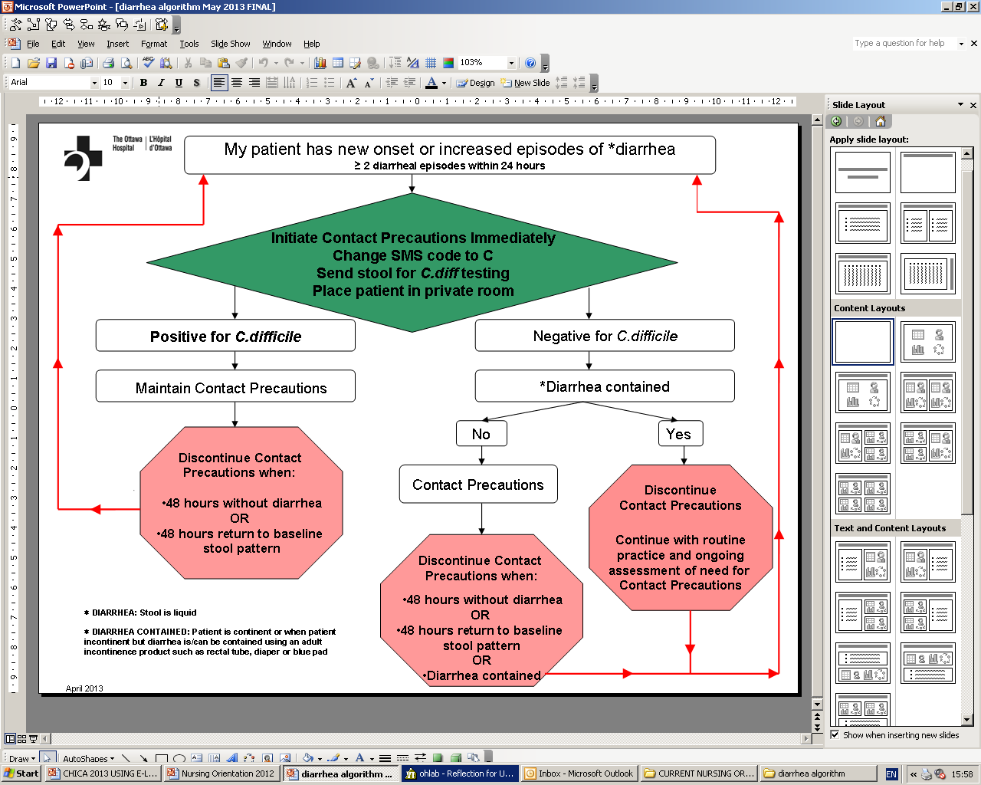
healthcare Associated Organisms

Slide 20
Group A Streptococcus (GAS)
GAS is a gram-positive bacteria that can live in the throat, rectum, or on the skin of healthy people
Occasionally this bacteria can cause infection, with mild symptoms such as sore throat
In extreme cases, this bacteria can cause severe infection in normally sterile tissues such as blood or muscle
Notes:
It is commonly found in the throat and on the skin. For some people, GAS may exist in the throat, rectum, vagina, or on the skin without symptoms. Most infections caused by this organism are mild in nature, such as a sore throat, and do not require any special precautions.

Slide 21
Group A Streptococcus
Place patient on Contact and Droplet Precautions if severe or invasive disease (necrotizing fasciitis or Streptococcal Toxic Shock Syndrome) is suspected
Place patient on Contact and Droplet Precautions if wound growing GAS, and drainage not contained
Notes:
Place any patient who is suspected of having Invasive Group A Streptococcus disease, necrotizing fasciitis or Toxic Shock Syndrome in a private room and institute Contact Precautions
For any patient who has a wound with uncontained drainage and Group A Streptococcus has been confirmed or suspected:
Initiate Contact Precautions immediately
If possible, limit movement of the patient in hospital while contact precautions are in place.
Notify Infection Control of any GAS infections
Routine practice is sufficient for patients with minor wounds and controlled drainage

Slide 22
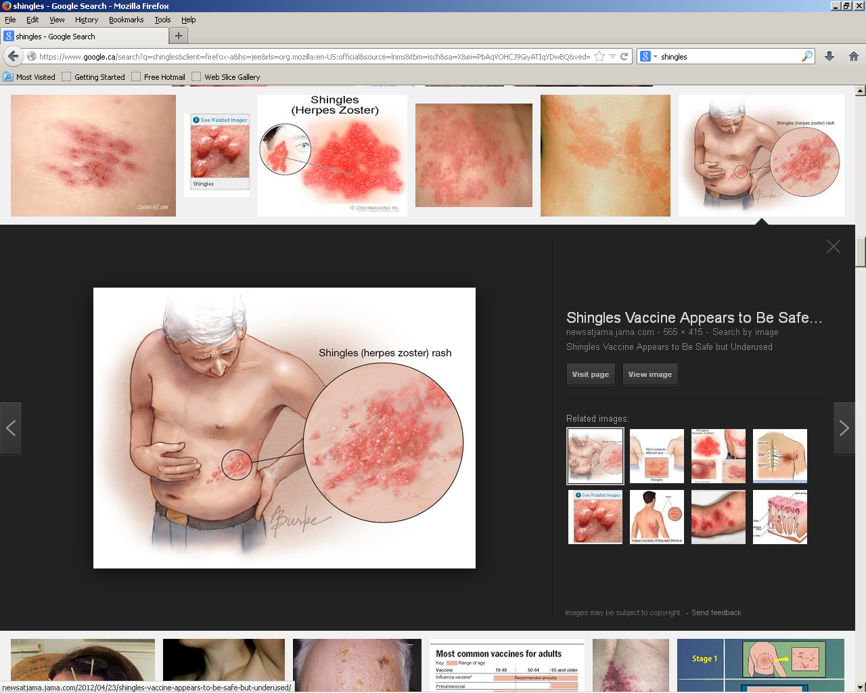
Shingles
AKA Herpes Zoster
Following primary chickenpox infection, Varicella zoster virus remains dormant in sensory nerve ganglia
Shingles is a reactivation of dormant Varicella zoster virus
Shingles is always a reactivation of one’s own virus
The risk of shingles increases with age
It is not caused by the same virus as genital herpes

Slide 23
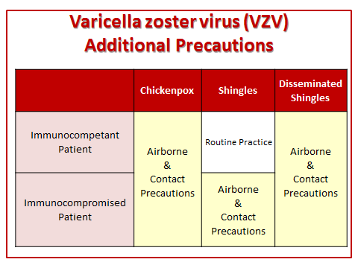
Shingles

Slide 24
Shingles Algorithm
Are all lesions
fully dry?
Yes
No precautions
required
No
Is patient
*immunocompromised
Yes
Airborne & Contact
Precautions
Required
No
3 or more dermatomes
affected (see chart)
Yes
No
Routine Practice
*Immunocompromised: BMT < 2 years regardless of varicella history, solid organ transplant, solid tumors and malignancies not in remission, advanced HIV infection, receipt high-dose corticosteroid or other immunosuppressive medication
IPAC May 2016

Slide 25
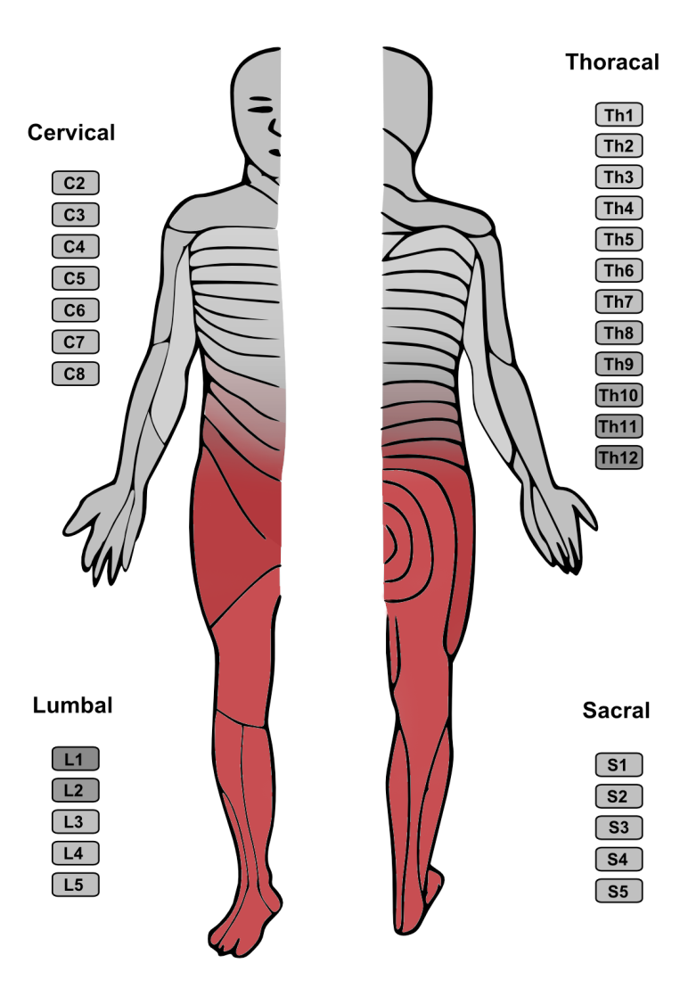

Slide 26
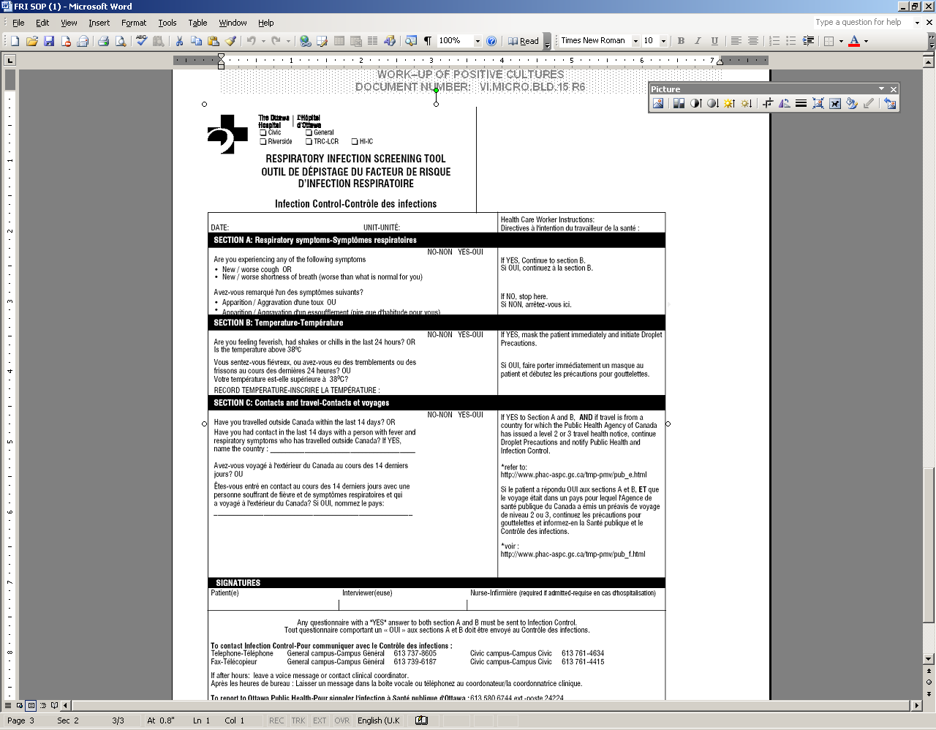
Febrile respiratory illness (FRI)
FRI includes:
Influenza
Para influenza
Respiratory syncytial virus (RSV)
Human metapneumovirus
The FRI screening tool should be filled out for every patient admission
Notes:
In Canada, influenza and community-acquired pneumonia (CAP) account for 60,000 hospitalizations and 8,000 deaths annually, and are the leading cause of death from infectious disease.
In the hospital, there is significant risk of transmission of acute respiratory infection (ARI) to patients and staff.
This is due to:
the large number of people (i.e., patients, family members, volunteers, visitors, workers) who come and go in the hospital
the ease with which droplet-spread respiratory illnesses can pass from one person to another
the fact that many patients have other illnesses that make them more likely to experience complications from respiratory infections
the large number of people who seek care for or develop acute respiratory illness in the hospital
The form you see on this slide is the respiratory infection screening tool. This tool should be filled out for every patient on admission.

Slide 27
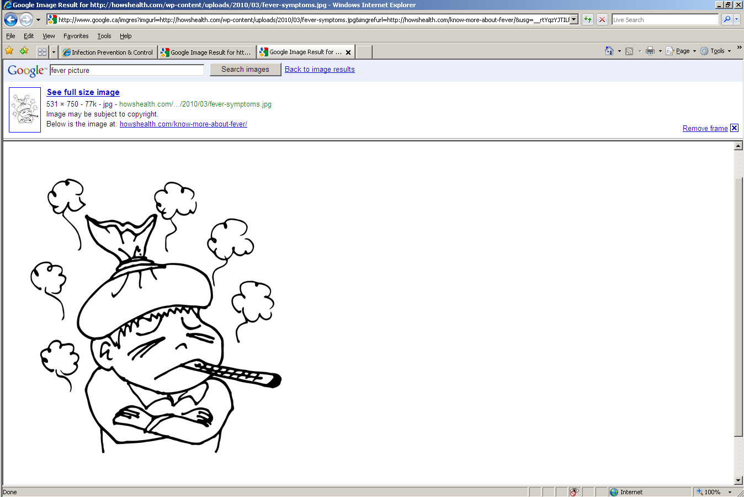
Febrile respiratory illness
All patients should be assessed daily for fever accompanied by new/worsening cough or shortness of breath

Slide 28
Antibiotic Resistant Organisms (ARO)
AROs include:
MRSA (Methicillin Resistant Staphylococcus Aureus)
ESBL (Extended Spectrum Beta-Lactamase)
MDRO (Multi-drug Resistant Organisms)
CPE (Carbapenemase-producing Enterobacteriaceae)
AROs can cause blood stream infections, pneumonias, UTIs, soft tissue, and various intra-abdominal infections. Bacterial resistance makes them difficult to treat
Notes:
All of these are acronyms for names of bacteria that have resistance to certain antibiotic classes.
MRSA is Methicillin Resistant Staphylococcus Aureus
VRE is Vancomycin Resistant Enterococcus
ESBL is a bacteria that carries the enzyme causing resistance called Extended Spectrum Beta-Lactamase
KPC is Klebsiella Pneumonia Carbapenemase
NDM1 is a bacteria that carries the enzyme causing resistance called New Delhi Metallo-beta-lactamase
Most patients identified with one of the above ARO will only be carriers of these resistant bacteria, few will develop an infection needing treatment. It is important to note that some patients can be carriers of more than one ARO
ARO can cause blood stream infections, pneumonias, urinary tract infections, soft tissue, and various intra-abdominal infections. Bacterial resistance makes infections caused by these organisms more difficult to treat.

Slide 29
MRSA
Staphylococcus aureus resistant to all of the beta-lactam classes of antibiotics
Staphylococcus aureus can live in the nose, axilla, groin and rectum
Spread of MRSA occurs through direct contact between persons or through contact with contaminated objects or surfaces
Notes:
Methicillin Resistant Staphylococcus aureus (MRSA) strains have been found in increasing numbers throughout the Ottawa Carleton region. Treatment of MRSA infections is difficult and expensive. Furthermore, once MRSA has been introduced into the hospital environment, it is extremely difficult to get rid of.
Risk factors associated with becoming a carrier of MRSA include:
Chronic underlying diseases
Prolonged hospitalization
Broad-spectrum antibiotic therapy
the presence of invasive devices
stay in ICU
close proximity to a carrier of MRSA
In most cases, people are carriers of MRSA but are not infected with it.

Slide 30
Admission Screening for MRSA
All patients admitted through the Emergency Department are screened for MRSA
All patients admitted to critical care screened for MRSA (including transfers from another TOH unit)
All direct transfers are screened for MRSA (direct transfers include pts from; hospitals, long-term/chronic care facilities, group home, prison, TOH campuses, homeless shelters, seniors residence, etc)
Notes:
What does “all direct transfers” mean?
Patients transferred from one of the following facilities:
Hospital, Long-term or chronic care facility, seniors’ residence, group home, rehabilitation center
Prison, homeless shelters
Patients transferred between TOH campuses, including the University of Ottawa Heart Institute and the Rehabilitation Centre
Exclusions:
Patient admitted to an over night stay unit
Psychiatry patients
Obstetrical and antepartum patients
NICU/SCN
All elective surgeries except for direct transfers

Slide 31
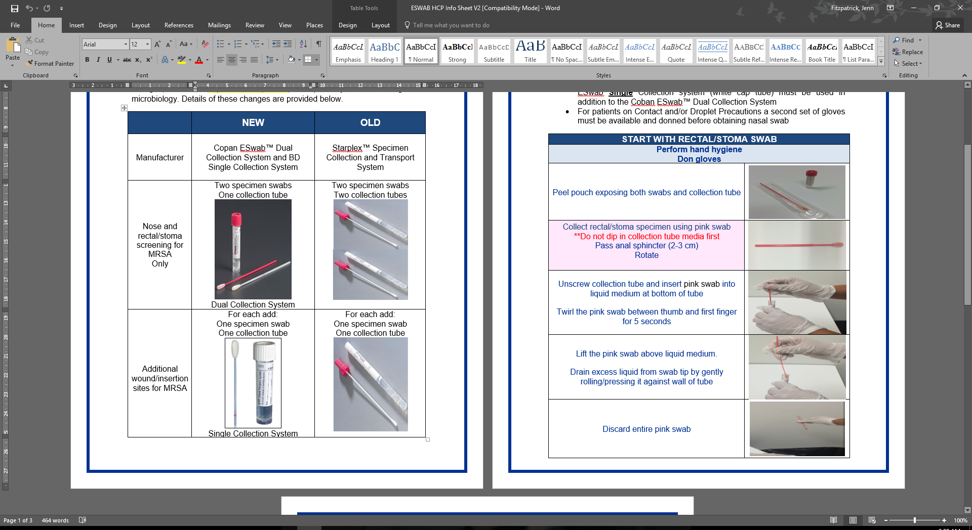
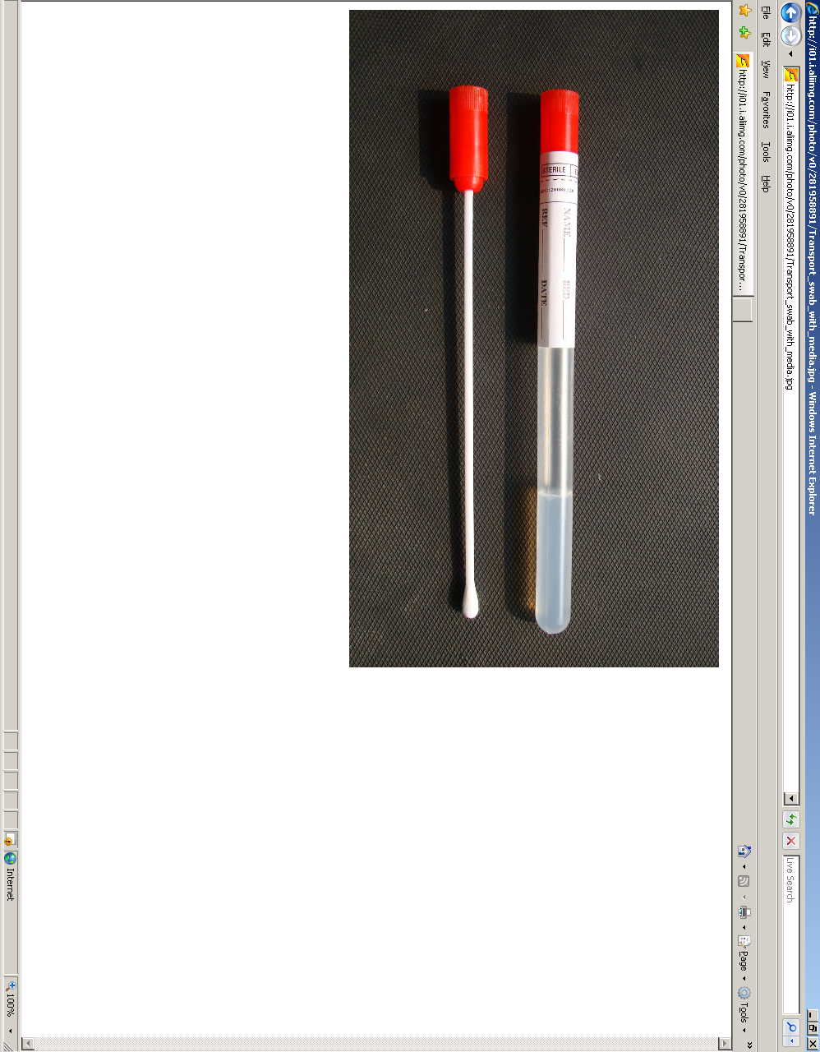
Admission Screening for MRSA
MRSA
Swab rectum and nose
If wounds or insertion sites, pick 2 and swab
Notes:
If your patient is admitted through the ER, please check vOACIS to ensure that MRSA screening has been done.
If your patient is a direct admit from home, no screening needs to be done.
If your patient comes directly from another facility please screen for MRSA and VRE. If your patient does not have any open wounds or insertion sites, a total of 3 swabs should be sent to microbiology.

Slide 32
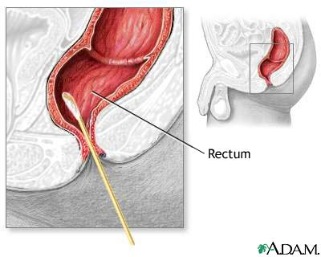
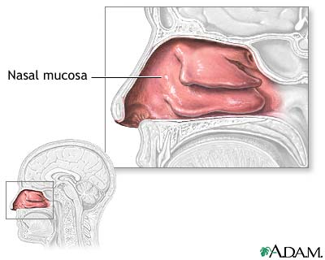
Admission Screening for MRSA
Rectal/stoma swab
  Use pink swab
  Pass anal sphincter (2-3cm)
  Rotate
  Insert swab into liquid medium and gently twirl swab
  Gently roll swab against wall of collection tube to drain excess liquid and discard pink swab
Nose swab
  Use white swab
  Insert into nostrils (1-2cm) and rotate twice.
  Insert swab into tube and break off at colored break point line

Slide 33
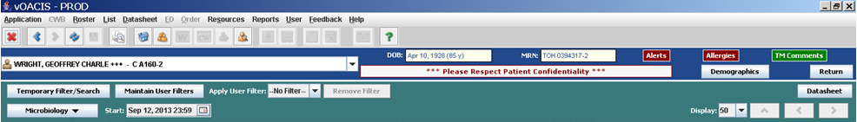
Healthcare Associated Organisms
Alerts in vOACIS for ARO
Notes:
All patients who are identified as having an ARO are flagged electronically in vOACIS.
Upon notification of an ARO isolate, Infection Prevention and Control will place an ARO alert code for that patient in the SMS system.
The unit clerk must change the condition code to “C” in the SMS system.
Example: A patient who was screened on admission for MRSA has been found positive. Infection Prevention and Control will place and electronic flag in vOACIS, which will communicate the patient’s MRSA status to all health care providers.
If this electronic flag is present, but the patient tests negative for the organism, it doesn’t change the patients status. Always follow the electronic flag when patient ARO status is questionable.
Should there be a discrepancy in what vOacis shows as an ARO and what the patient tells you his/her status is, please contact Infection Prevention and Control

Slide 34
Modification of Contact Precautions
Criteria:
  Patient must be compliant with hand hygiene prior to exiting their room
The following patients do not meet criteria for Modified Contact Precautions:
  Patients with diarrhea
  Patients with Carbapenemase-producing Enterobacteriaceae (CPE)
  Patients on another type of additional precaution (Droplet or Airborne)

Slide 35
Additional Precautions
Used in addition to Routine Practices and include:
  Contact Precautions
  Droplet Precautions
  Airborne Precautions
  Aerosal Generating Respiratory Procedures
Used for patients known or suspected to be infected or colonized with certain microorganisms . Interrupts spread of dangerous bacteria and viruses in the hospital setting

Slide 36
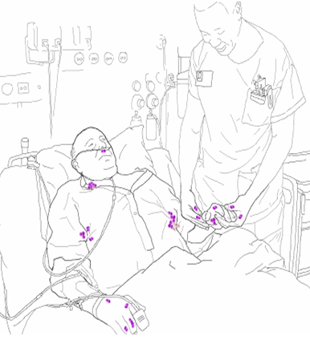
Contact precautions
Contact Precautions:
To reduce the spread of dangerous bacteria and viruses that may be present on the skin of patients skin or contaminated environmental surfaces
Used when providing care to patients with uncontained drainage, or identified as carriers of antibiotic resistant organisms
Notes:
There are two ways bacteria and viruses are spread by contact:
Direct contact - person to person
or
Indirect contact - via contaminated equipment, environmental surfaces, or contaminated hands

Slide 37
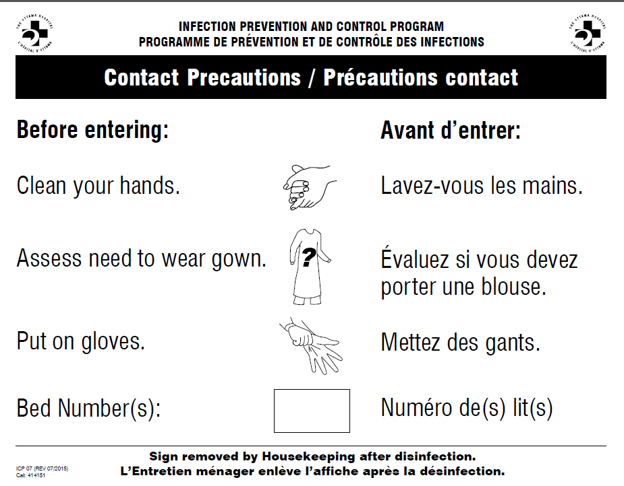
Contact precautions
PPE for Staff
Gloves
Assess need to wear gown (When clothing/skin in contact with patient/patient environment)
PPE for Visitors
Gloves and gown required only when providing direct care
Notes:
Contact Precautions must be initiated by any health care professional when there is a risk of contact transmission (e.g. diarrhea, uncontained wound drainage, fecal incontinence or other discharges that increase transmission risk or identification of an organism known to be transmitted by the contact route).
Preferred Patient Placement
Single room with a dedicated toilet and patient sink
Door may remain open
If private room is not available consider the following placement options:
Semi private room with a blocked bed
Cohorting patients who are confirmed to have the same infectious agent. This is to be done in consultation with Infection Control /Clinical Coordinator

Slide 38
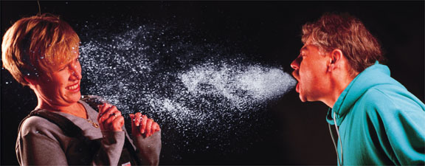
Droplet precautions
Droplet Precautions:
To prevent the contamination of mucous membranes by large droplets generated by an individuals respiratory secretions
Droplets remain suspended in the air for a short period of time then fall to environmental surfaces within 2 meters
Disease examples include; influenza, bacterial meningitis, mumps, pertussis, parvovirus B19
Notes:
Droplet transmission occurs when mucous membranes (nose and mouth) and/or conjunctivae are contaminated by large droplets (usually >5 microns) generated by an individual’s respiratory secretions; when a person coughs, sneezes, or talks, or during aerosol generating procedures such as open airway suctioning, bronchoscopy and intubation. These droplets remain suspended in the air for a short period and fall on surfaces within 2 meters (6 feet). These contaminated surfaces can be a source of contact transmission.

Slide 39
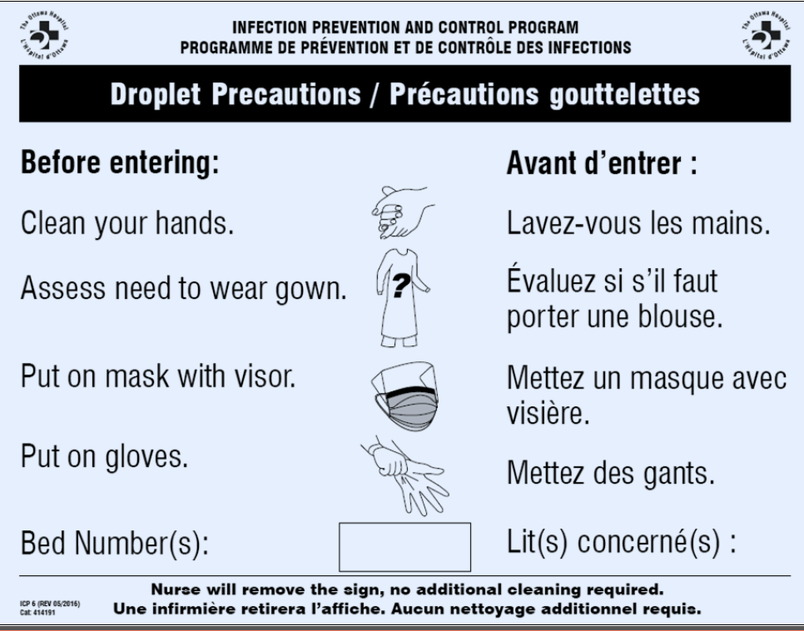
Droplet precautions
PPE for Staff within 2m of patient
Mask with visor
Gloves
Assess need to wear gown (When clothing/skin in contact with patient/patient environment)
PPE for Visitors
Mask with visor
Gloves and gown required only when providing direct care
Notes:
Droplet precautions must be initiated by a health care providers at the onset of symptoms suggestive of droplet transmission infection by any health care provider.
Do not wait for lab confirmation. Notify Infection Control when droplet precautions is initiated
Patient Placement:
Single room with a dedicated washroom and patient sink. The door may be left open.
If a single room is not available the following placement can be considered:
Semi-private with the other bed closed. The unit needs to notify the Admitting Department.
Individually isolate the patient within a ward room. A spatial separation of 2 meters is to be maintained in between patients. Curtains are pulled in between patients.

Slide 40
Droplet Precautions
Droplet precautions patients in a shared room:
Droplet precautions sign must be placed on door to room and on pulled curtain of individual patient
When patient exiting their bed space to use the washroom, or for a procedure they should be instructed to clean their hands and wear a procedure mask
Patient does not wear a mask with visor
This does not mean the patient can have modified precautions
Once the patient has been removed from droplet precautions, the room does not need to be cleaned

Slide 41
Airborne precautions
Airborne Precautions:
Small droplet nuclei are generated by the infectious person when he/she talks, coughs or sneezes
Droplet nuclei stay suspended in the air and travel through air currents and ventilation systems
Droplets are inhaled by susceptible persons including health care providers
Disease examples include; chickenpox, measles, tuberculosis, disseminated shingles, smallpox

Slide 42
Airborne precautions
PPE for Staff
Fit tested N95 mask
PPE for Visitors
Generic N95 mask
Notes:
Initiation of Airborne Precautions
• Airborne precautions must be instituted at the onset of symptoms suggestive of airborne transmitted infection by any health care provider
Notify Infection Prevention and Control if Airborne Precautions are initiated
• Infection Control or delegate will notify Engineering and Operations that they need to verify if the AIIR is functioning properly.
• Patient must be moved to an airborne infection isolation room (AIIR) as soon as possible
• The door of the patient’s room must be kept closed at all times, even when the patient is not in the room. The door between the anteroom and the hall must all be kept closed at all times.
While waiting to transfer the patient to an AIIR, the health care provider should:
Have the patient put on a surgical/procedure mask
If the patient is in a ward room, pull the curtains and place the airborne sign on the curtain
If the patient is in a private room, close the door and place the sign on the door.

Slide 43

Aerosol generating respiratory procedures
Aerosol Generating Respiratory Procedures:
Procedure with the potential to generate a high volume of respiratory droplets and aerosols. The procedure may propel droplets over a radius of two meters
Procedures may propel droplets over a radius of two meters
Notes:
Aerosol: small droplet of moisture that may carry microorganisms. Aerosols may be light enough to remain suspended in the air for short periods of time, allowing inhalation of the microorganism.
The following are examples of the most frequently used aerosol-generating procedures:
Aerosolized or nebulizer medication administration/ therapies
Use of bag-valve mask to ventilate patient
Endotracheal intubation, at any time
Extubation
Open airway suctioning
Sputum induction (N95 mask always required)
Bronchoscopy (N95 required for diagnostic bronchoscopy when TB is in the differential diagnosis)
Other upper airway endoscopy,
Mechanical ventilation: high-frequency oscillatory ventilation, circuit changes, HME filter changes, circuit disconnections/openings
In- Exsufflation
Manual lung volume recruitment
Chest physiotherapy
Assisted cough maneuvers
Open thoracotomy
Tracheotomy and tracheostomy care
Tube or needle thoracotomy
Non-invasive positive pressure ventilation e.g., CPAP, BiPAP
Aerosol humidification and oxygen concentrations of 50% or higher
Spirometry and pulmonary function testing
Prior to any procedure, the health care provider must assess the potential for generating aerosols or droplets and must use the appropriate protection

Slide 44
Aerosol generating respiratory precautions
PPE for Staff
Mask with visor
Wear gown and gloves when skin and clothing will be in contact with patient or the soiled environment
PPE for Visitors
Mask with visor
Wear gown and gloves when skin and clothing will be in contact with patient or the soiled environment

Slide 45
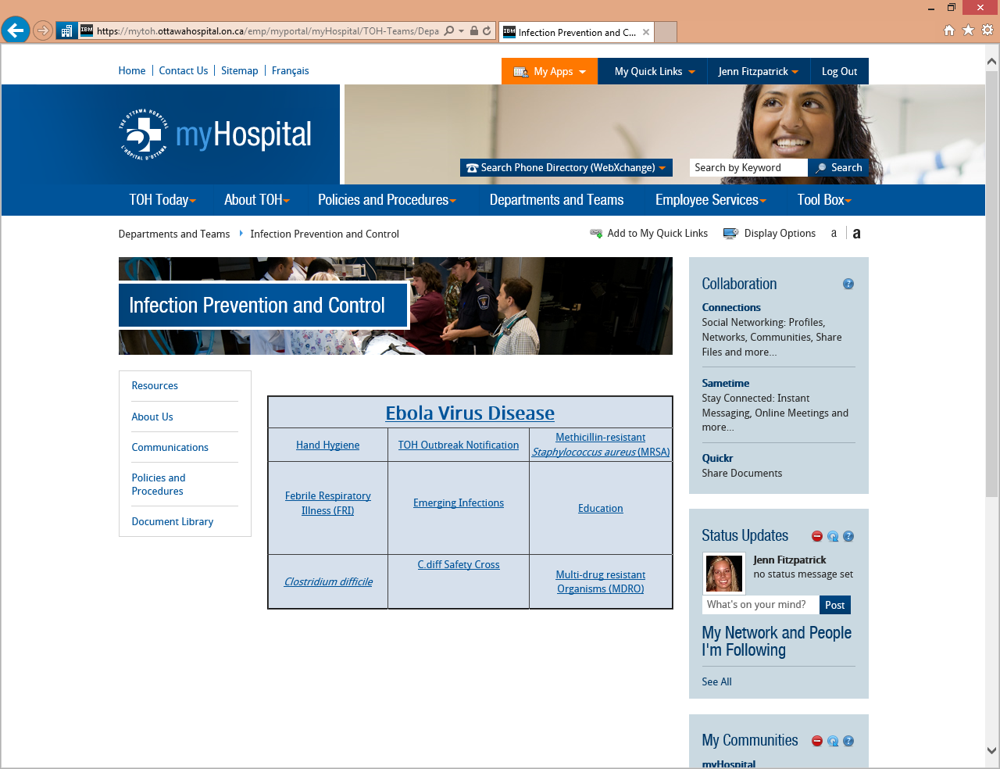
How to Find Information About IPAC

